Slide 1
Project Explanation
Car Dheko - Used Car Price Prediction

Slide 2
INTRODUCTION
I will built the app for predict the car price to Car-dheko Company by existing dataset gathered from our company data portal
I will preprocess the dataset as per gathered
I will run machine learning model for accuracy of data
Finally built the app through streamlet application

Slide 3
Dataset
I got multiple dataset depends on multiple City like Bangalore, Chennai, Hyderabad, Jaipur, Kolkata ,Delhi
Overview of dataset like in JSON format
I decided to start the Preprocess the individual Column like new_car_detail, new_car_feature, new_car_overview, new_car specs
Let try to flatten the each column is dictionary, list of dictionary, dictionary of dictionary available .

Slide 4
New_CAR_Detail - EXTRACTION
First I read the dataset from local path by using pandas package
Then I took first column (new_car_detail)
I create function name “Convert_to_Json_format” – This function contains replace the ‘ to “, None to Null , True to true , False to false and some regression format
Then apply the function to new_car_ detail Dataframe variable
Then another function create for flatten the json column “flatten_json_column”
Finally Print the Structured Data

Slide 5
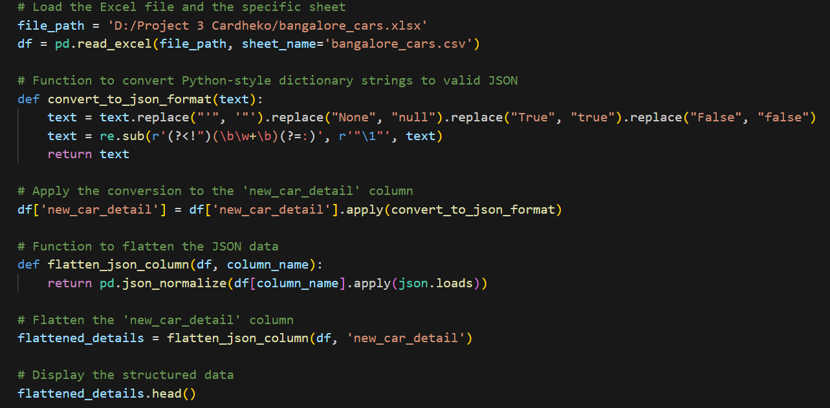
New_CAR_Detail - CODE

Slide 6
New_CAR_OVERVIEW - EXTRACTION
In this Column are have Dictionary and list of dictionary
First I replace ‘ to “ , None to 1 by using lambda function
Then I create the new function name called “Car_overview_dict_creator”
This function takes a nested dictionary structure with a list of car features(Where each feature have a key and value), and it extracts these into a simpler,flat dictionary
The Keys represent car features, and the values represent the corresponding feature values
Then apply with the lambda function after print the structured format

Slide 7
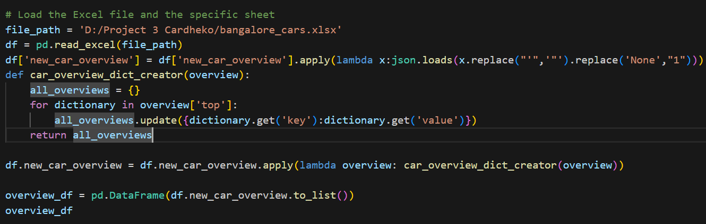
New_CAR_OVERVIEW - CODE

Slide 8
New_CAR_FEATURE - EXTRACTION
First I clean and parse JSON – like strings in this column like replace ‘ to “ and None to 1
Create the function to flatten the new_car_feature column
In this function I extract the ‘Common icon’ , ‘top’ , ‘data feature with heading and subheading’ from the new_car_feature column
Then apply the function to this column and find extract and flatten data from this column
After convert the flattened feature into a Dataframe
Finally concatenate the original dataframe with the new feature dataframe and display the result

Slide 9
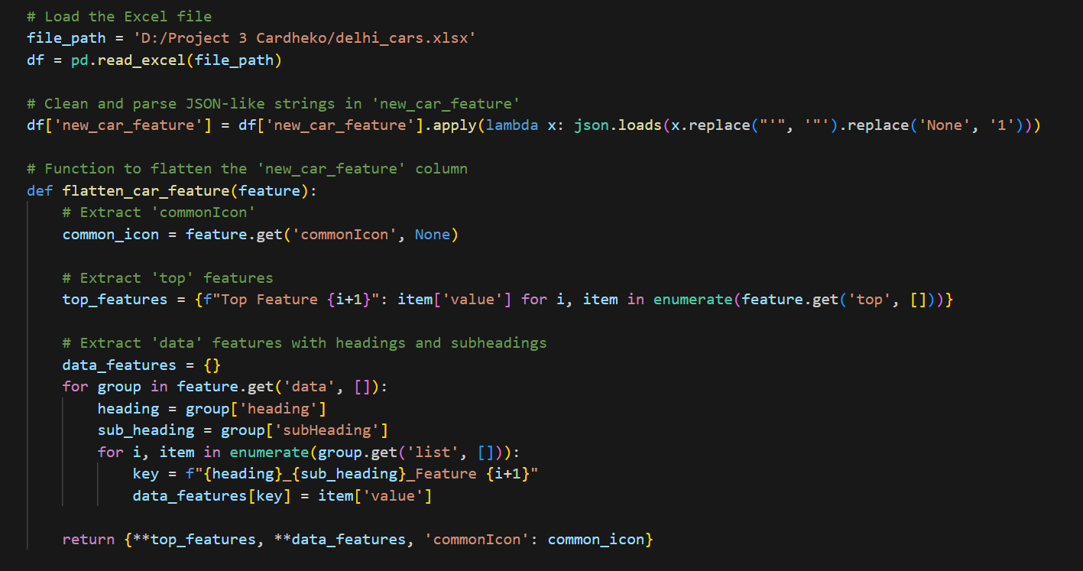
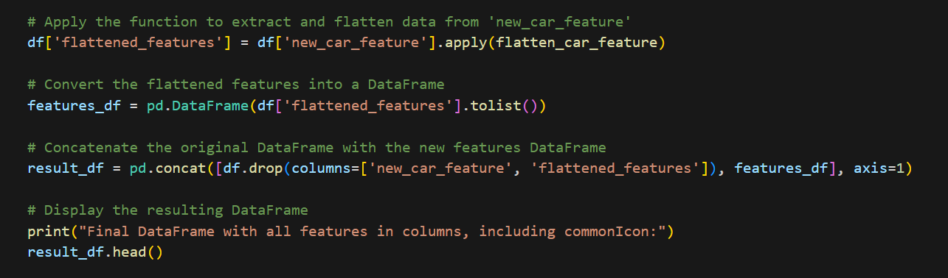
New_CAR_FEATURE - CODE

Slide 10
New_CAR_SPECS - EXTRACTION
First I clean and parse JSON – like strings in this column like replace ‘ to “ and None to 1
Create the function to flatten the new_car_specs column
In this function I extract the ‘top’ , ‘data feature with heading and subheading’ from the new_car_feature column
Then apply the function to this column and find extract and flatten data from this column
After convert the flattened feature into a Dataframe
Finally concatenate the original dataframe with the new feature dataframe and display the result

Slide 11
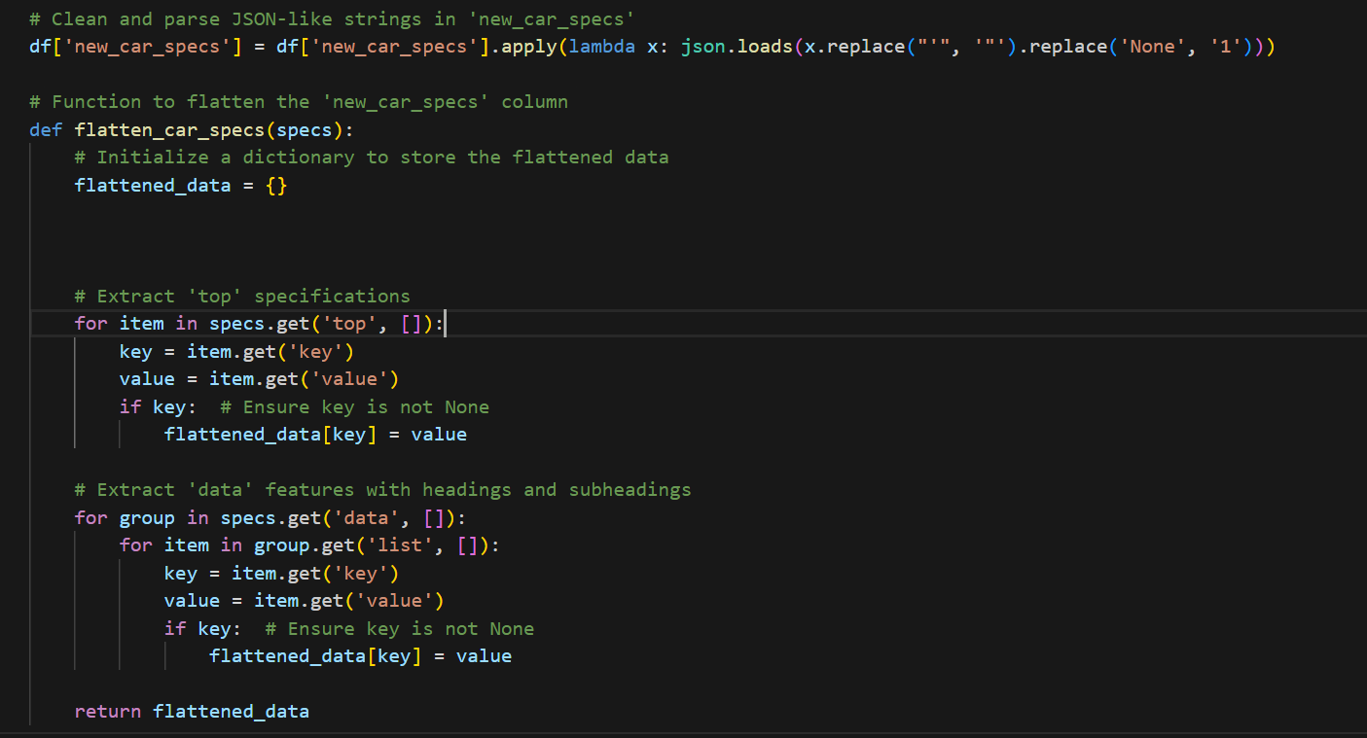
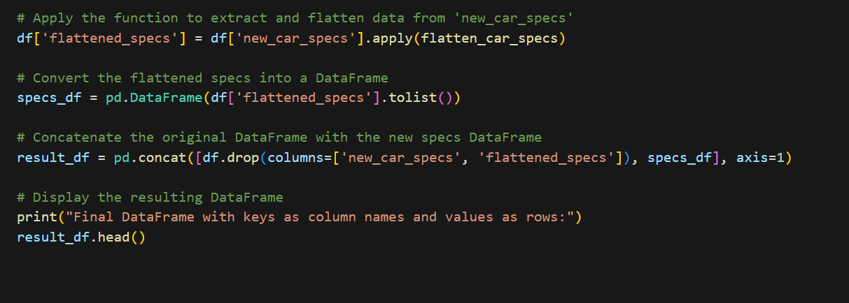
New_CAR_SPECS - CODE

Slide 12
MERGE OR CONCATENATE
Above each slides are represents flatten each column in single dataset
Each operations are handled balance dataset
After I used concatenate horizontally method to merge the each column
I create the new column name ‘City’ in each dataset, stored in csv file also
Then iterate through all csv files in the directory for merge each csv file in to single dataframe
Finally together all datset given the results like 8369 rows,232 columns

Slide 13
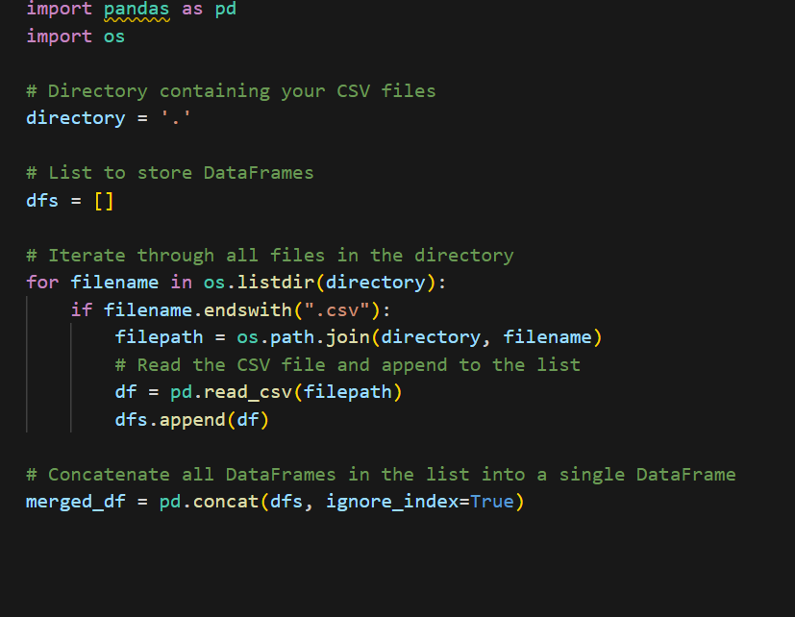
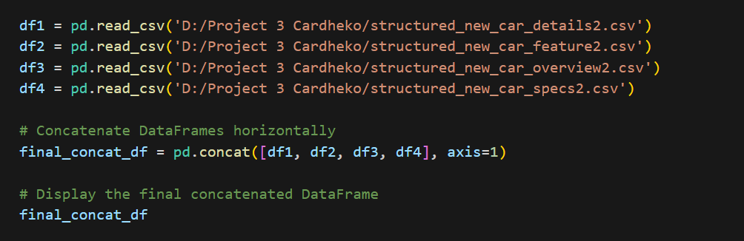
CONCATENATE - CODE

Slide 14
DROP & FILL COLUMNS
From the dataset I got too much null values some of columns
I drop all the columns which have high number of null values
Some of columns especially categorical column which have less number of null values, I used forward fill method
Balance columns like numerical column maximum I fill the nan values
I found the unique values from each column
After I replace the unique values
Finally used mode or median or mean function for depends numerical column to fill null values

Slide 15
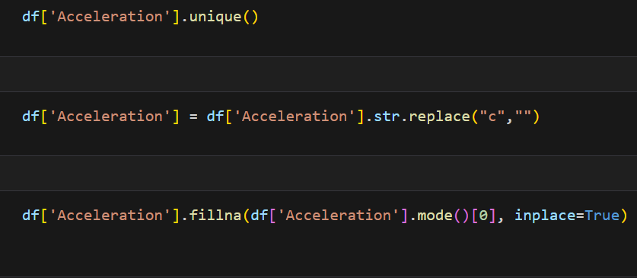
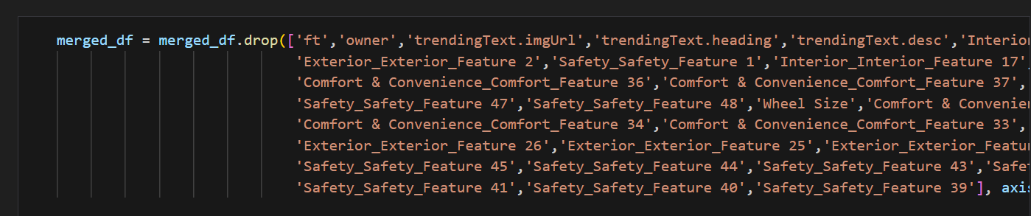
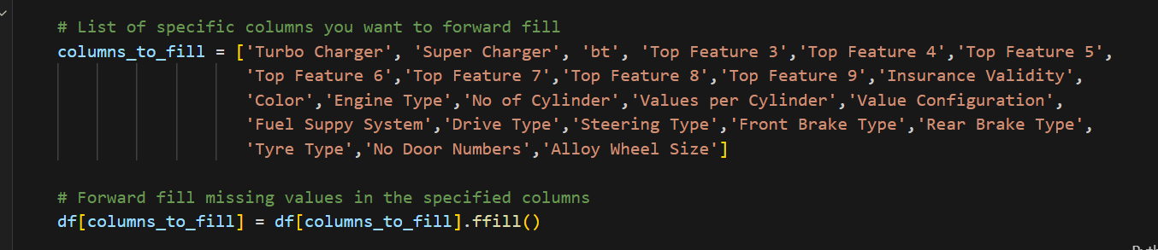
DROP & FILL - CODE

Slide 16
OUTLIERS DETECTION
After fill the nan values in this dataset ,I choose around 14 columns including Target columns for machine learning model
Column names are Bt, km, Owner no, Model year, Fuel type, seats, Transmission, Mileage ,Engine, Color, City, Steering Type, Insurance, Price
First I took the ‘Mileage’ Column for check outliers
I install the seaborn library for visualize the flow of data
Distplot and boxplot are mainly used for outlier detection
……………CONTINUE…………..

Slide 17
OUTLIERS DETECTION - CONTINUE
After the visualization I found IQR from this column by using Percentile25, Pecentile75 calculation method
Then I calculate upperlimit and lowerlimit of the column
Compare the upperlimit to the column for outlier detection
Outliers are from the ‘Mileage’ columns are greater than upperlimit and less than lowerlimit
Then trimmed the column from outliers by using comparision method
First I took less than upperlimit values ,from these values I took greater than lowerlimit
In these methods are using to all numerical columns like Km, Engine, Owner no, Model year, Price and excluding Seats because of logically thinking

Slide 18
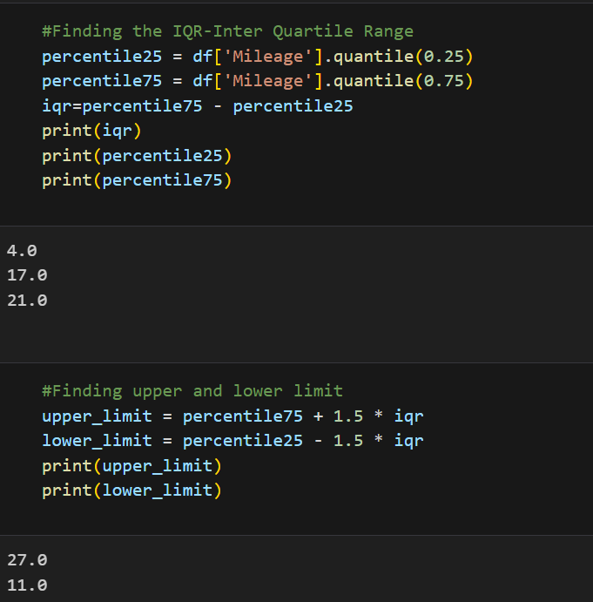
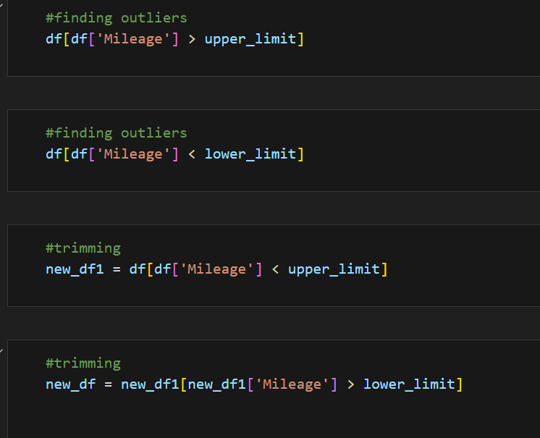
OUTLIERS DETECTION - CODE

Slide 19
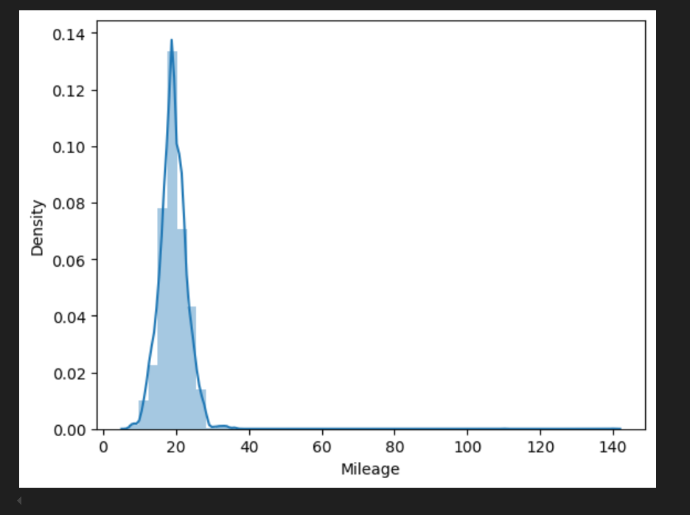
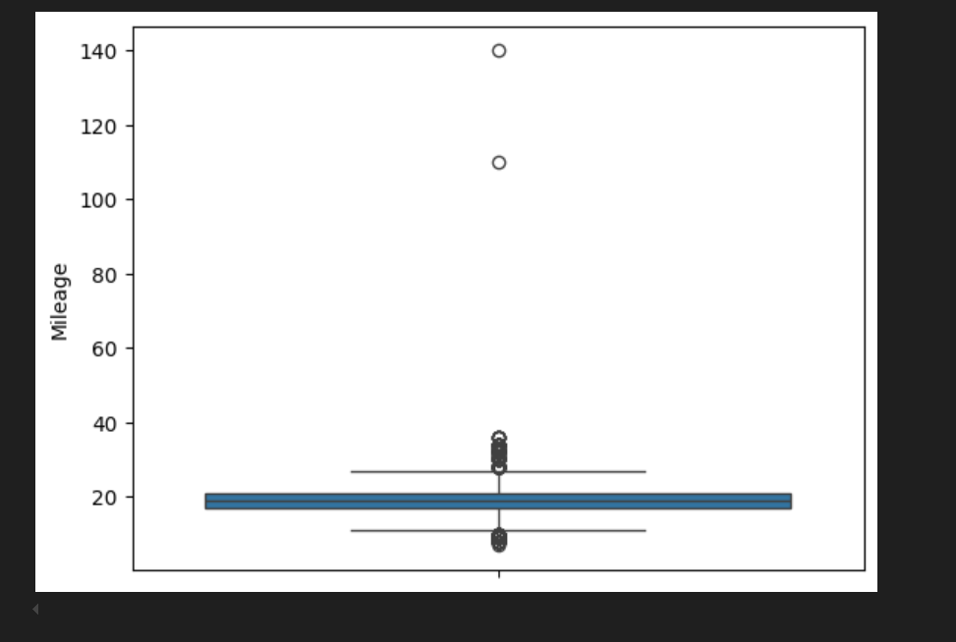
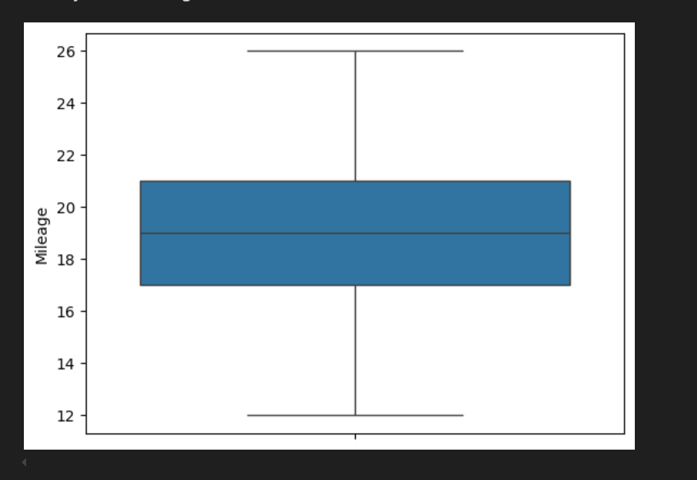
OUTLIERS DETECTION - VISUALIZE

Slide 20
TARGET - ENCODING - SPLIT
After outlier detection then push for select the best regression model
Assume the feature column and target column
From this dataset I took price for target column as price prediction rest of 13 column are features
First I encoding the categorical column into the numerical column
We could train the machine learning model by using only numerical data
after I split the dataset 70% for train the model and 30% for test the model

Slide 21
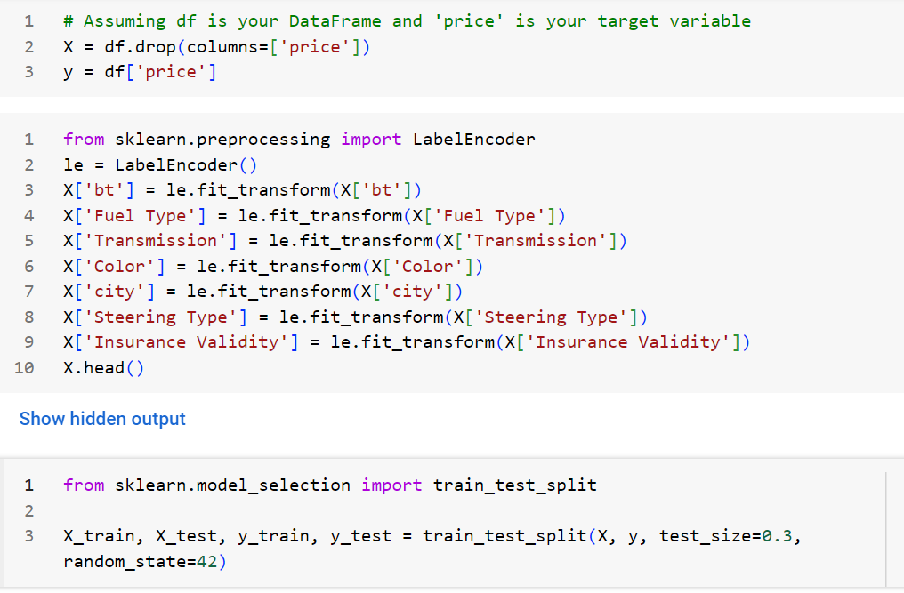
TARGET - ENCODING – SPLIT - CODE

Slide 22
LINEAR REGRESSION
First I select linear regression model for train and test the dataset
I create the linear regression model from the sklearn library
Train the model by using X-train, y-train
Make predictions on the test set by using X-test
Evaluate the model and find mean square error value and R-squared value
After the evaluation MSE-1.97, R2 score-0.72

Slide 23
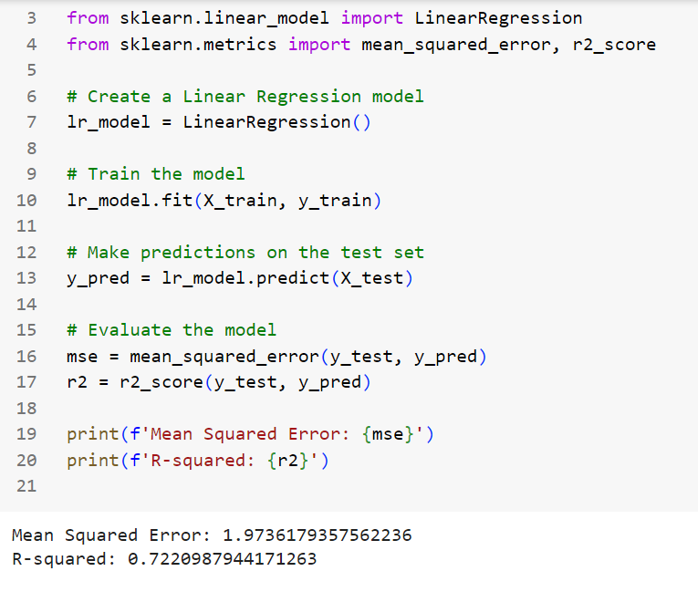
LINEAR REGRESSION - CODE

Slide 24
DECISION TREE
Second I select decision tree regression model for train and test the dataset
I create the decision tree regression model from the sklearn library
Train the model by using X-train, y-train
Make predictions on the test set by using X-test
Evaluate the model and find mean square error value and R-squared value
After the evaluation MSE-1.80, R2 score-0.74

Slide 25
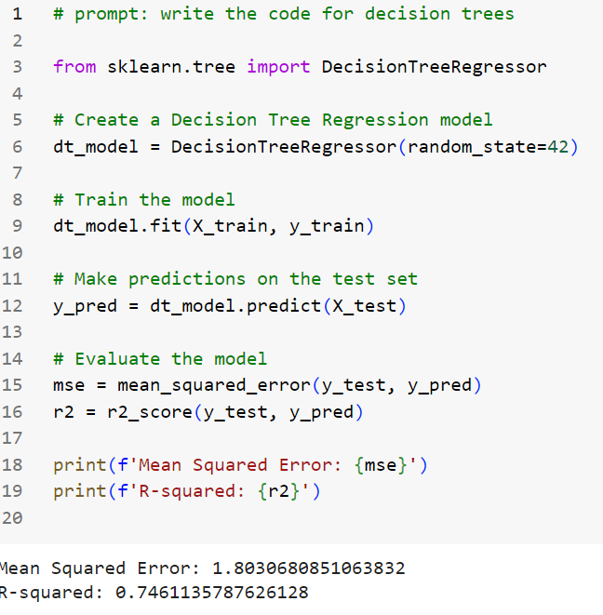
Decision tree - CODE

Slide 26
Random forest
Third I select random forest regression model for train and test the dataset
I create the random forest regression model from the sklearn library
Train the model by using X-train, y-train
Make predictions on the test set by using X-test
Evaluate the model and find mean square error value and R-squared value
After the evaluation MSE-0.90, R2 score-0.87

Slide 27
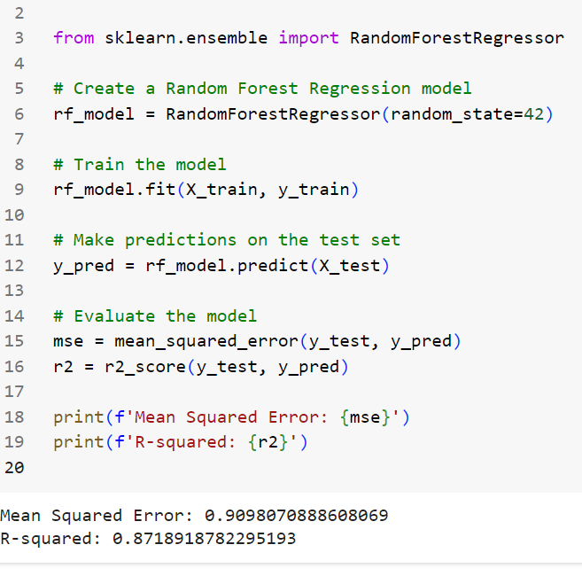
Random forest - CODE

Slide 28
GRADIENT BOOST
Final I select Gradient boost regression model for train and test the dataset
I create the Gradient boost regression model from the sklearn library
Train the model by using X-train, y-train
Make predictions on the test set by using X-test
Evaluate the model and find mean square error value and R-squared value
After the evaluation MSE-1.09, R2 score-0.84

Slide 29
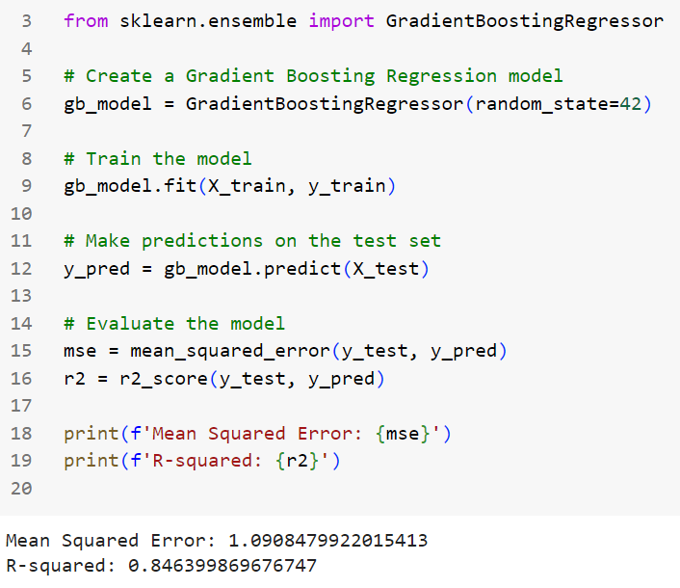
Gradient boost - CODE

Slide 30
Hyper parameter tuning
After train four regression model I took best model as random forest model
Compare to others random forest had best R-squared value
Then I try hyper parameter tuning in random forest model by using gridsearch cross validation method
I define the parameter grid for gridsearchcv object and it contains n_estimators, max_depth, min_samples_split, min_samples_leaf
Create the random forest regressor model and GridsearchCV object
……………CONTINUE…………..

Slide 31
Hyper parameter tuning - CONTINUE
I put the value for gridsearchCV object contains like estimator, param_grid, cv, n_jobs, verbose
Fit the grid search to the data by X-train, y-train
Get the best parameter and best score from the grid search
After train the model with best parameters then I get best random forest model
From the model make the predictions on the test set
Evaluate the best random forest model I got MSE-0.89,R-squared-0.87

Slide 32
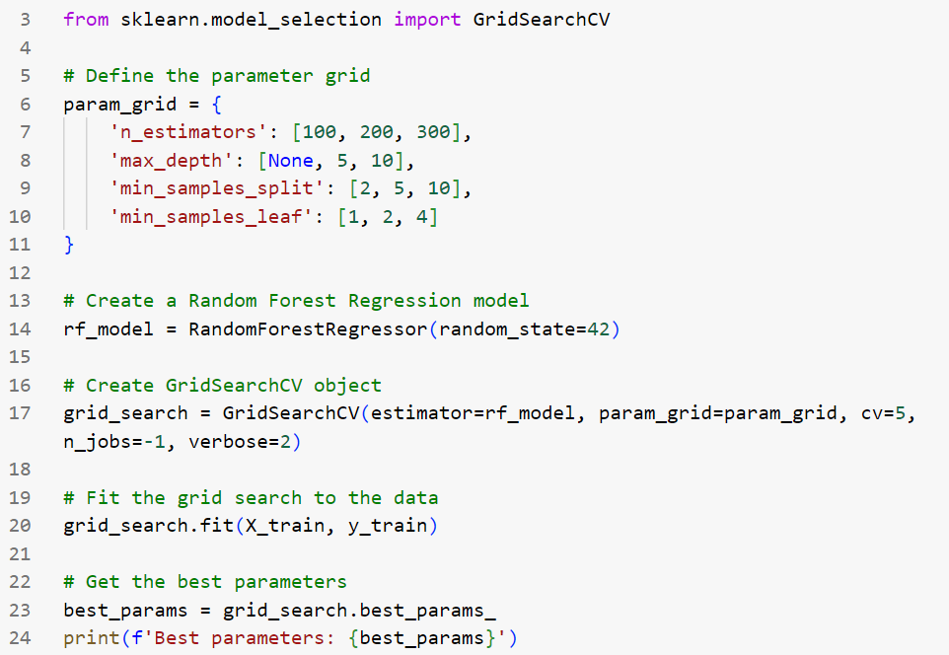
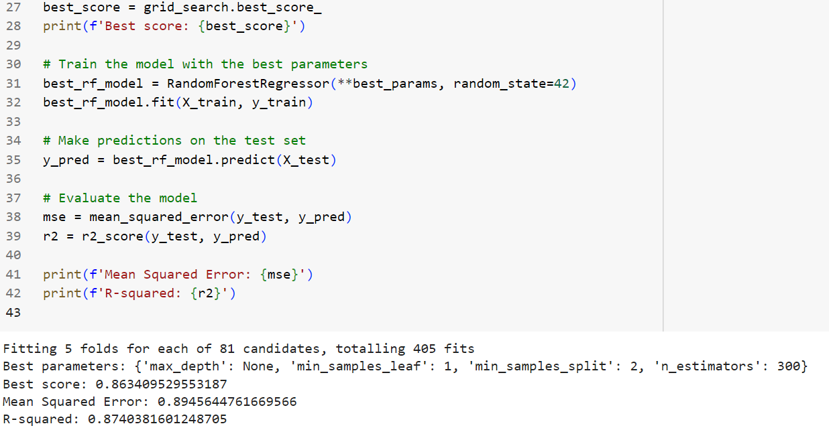
Hyper parameter tuning - CODE

Slide 33
RIDGE & LASSO
After hyper parameter tuning the model I check overfitting and underfitting by using ridge and lasso regularization method
Calculate the difference between testing and training R-squared values both ridge and lasso
After I analyze the difference with the threshold >0.1, <-0.1
Both ridge and also after comparison shows
Lasso model seems to have a good fit
Ridge model seems to have a good fit

Slide 34
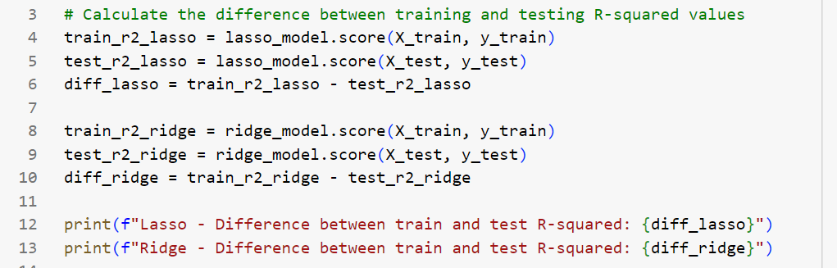
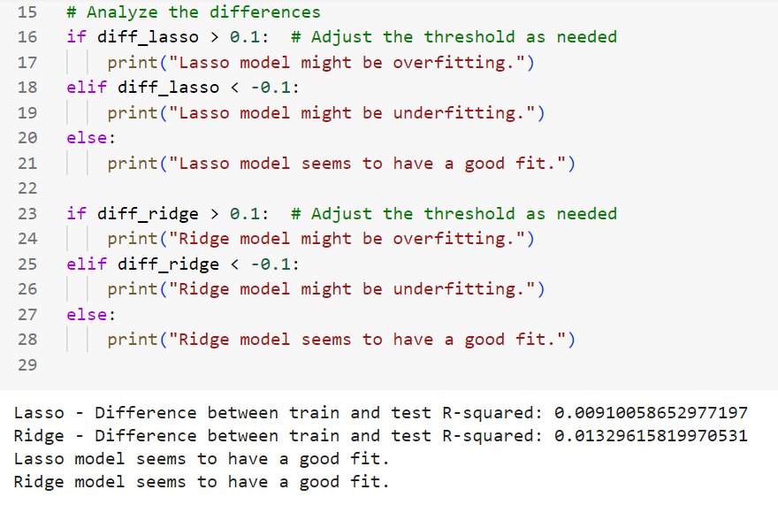
RIDGE & LASSO - CODE

Slide 35
Streamlit App
Finally I store the trained model in the pickle file for built the streamlit application in the python file
After I load the trained model into python file
Create the function for predict price based on given features
First I give the title for my application “Car price Prediction APP”
I put the Car logo for easy understanding
Create the input fields and fixed the where it will be located in the app
After encoding the categorical features in the column
Prepare the feature for prediction car price
If predict price button available try to call predict price function and it predicted

Slide 36
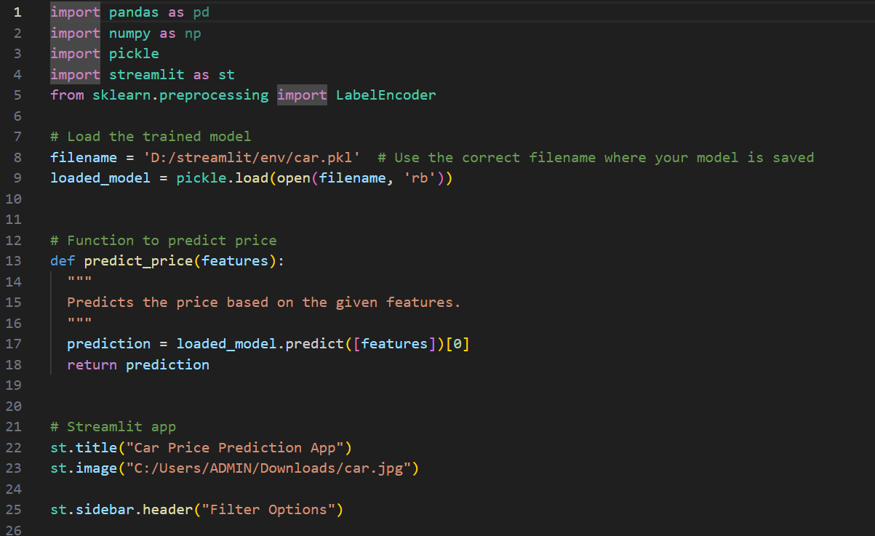
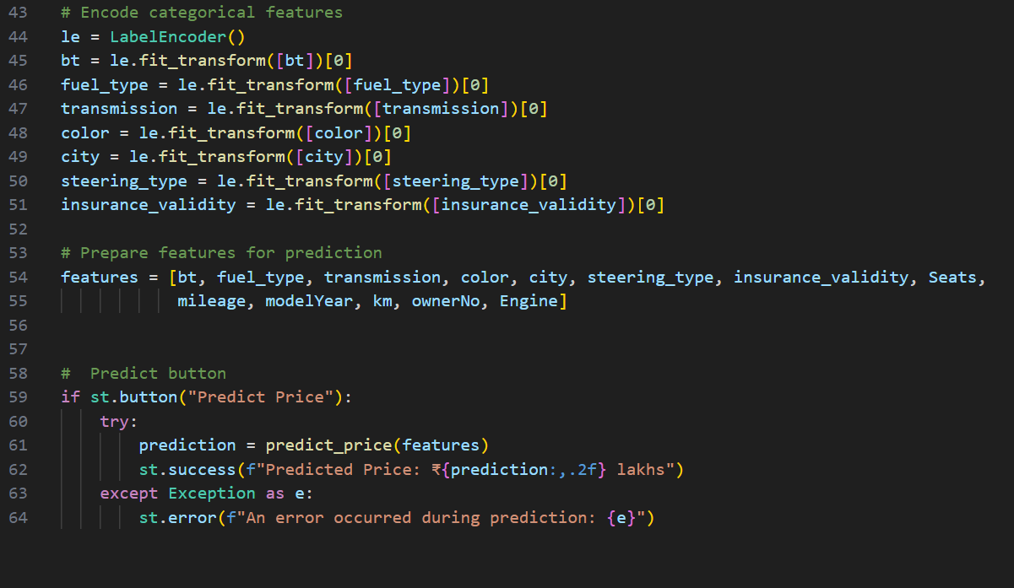
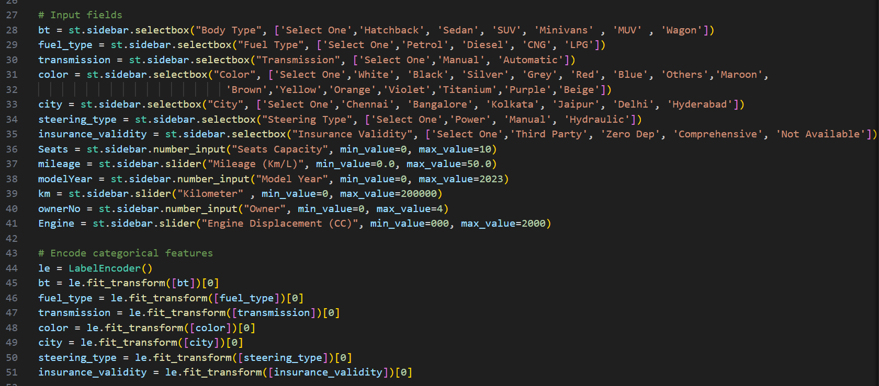
Streamlit app - CODE

Slide 37
USER GUIDE – CAR PRICE PREDICTION APP
Go to the application “Car Price Prediction”
Check your left side there is multiple filter options there
First body type, there is SUV, SEDAN, HATCHBACK etc., like multiple options there which type you want just click
Second Fuel Type, there is PETROL, DIESEL, LPG, CNG available which you prefer just click
Third Transmission, there is MANUAL, AUTOMATIC available which you prefer just click
Fourth Color, there is lots of color available like Red, Black, White, Silver etc., which you like just click
……………CONTINUE…………..

Slide 38
USER GUIDE – CAR PRICE PREDICTION APP
Fifth City, there is HYDERABAD, JAIPUR, CHENNAI, BANGALORE, DELHI, KOLKATA available which city nearby you just click
Sixth Steering type, there is POWER, HYDRAULIC, AUTOMATIC available which you prefer just click
Seventh Insurance Validity, there is ZERO DEP, THIRD PARTY, COMPREHESIVE, NOT AVAILABLE are available which you prefer just click
Eight Seats capacity, Maximum of 10 seats capacity available which you prefer just click + or enter manually
Nineth Mileage, so slide the dots towards right how much you maximum want
……………CONTINUE…………..

Slide 39
USER GUIDE – CAR PRICE PREDICTION APP
Tenth Model Year, From year of 2000 to 2023 available which model you want just click + or enter manually
Eleventh Kilometer, slide the dots towards right how much you maximum want
Twelve Owner, Maximum of 4 owners available which you prefer just click + or enter manually
Thirteen Engine Displacement, slide the dots towards right how much you maximum want
After the selection of these options downside of logo there is predict price button available just click you will get predicted price

Slide 40
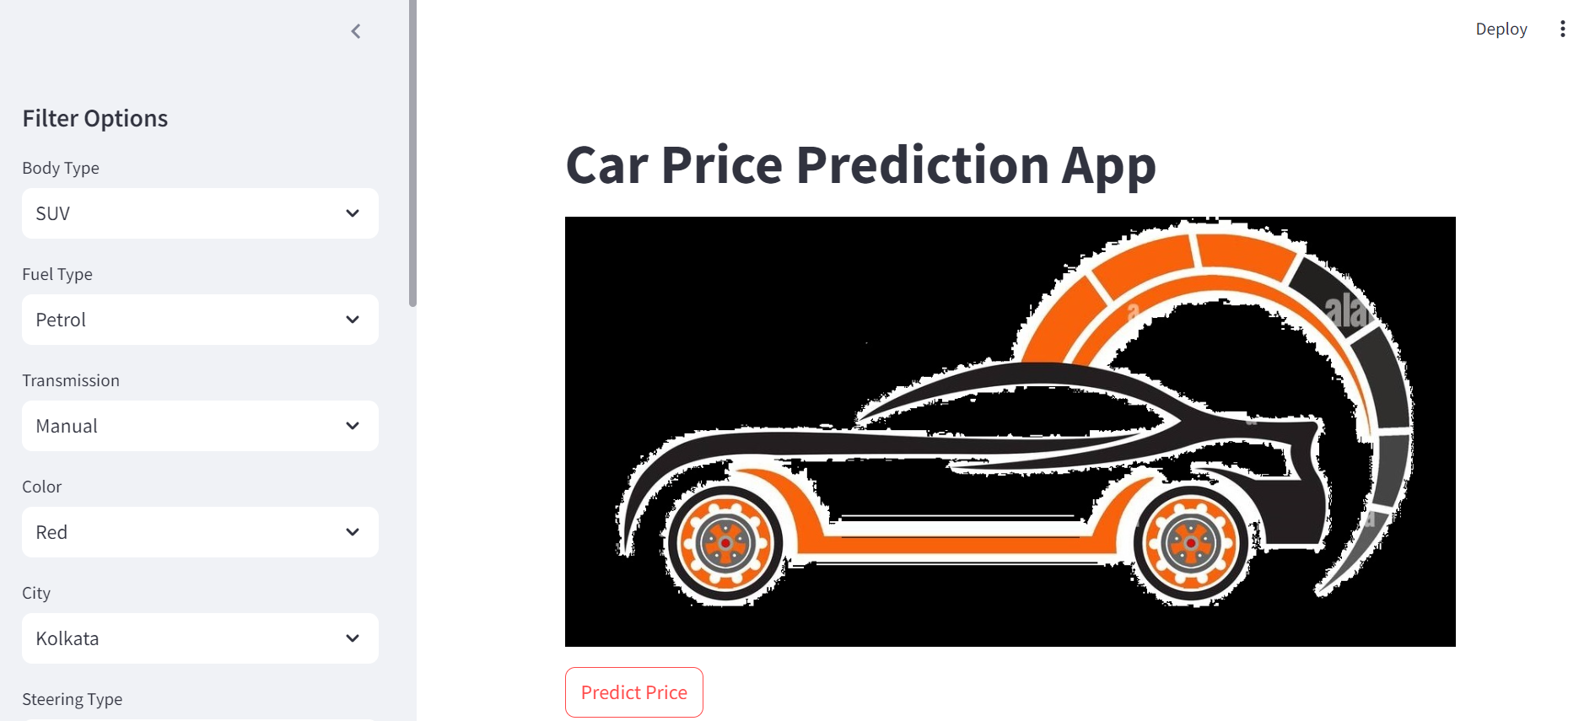
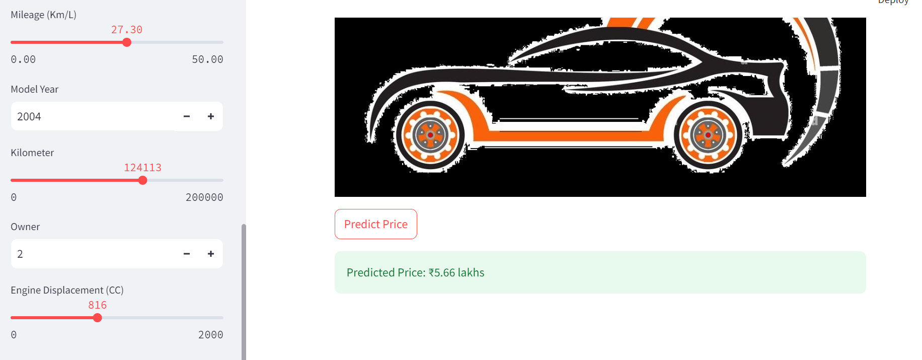
APP VISUAL

Slide 41
CONCLUSION
The machine learning model effectively predicts car prices based on features like body type, fuel type, and engine displacement. The Random Forest model, after hyperparameter tuning, performed the best among the models evaluated, with a good balance between accuracy and computational efficiency.
The project showcases the end-to-end process of data preprocessing, model training, and deployment of a machine learning model in a web application.

Slide 42


